Slide 1
BeerPal
Beer Rating App
Developers
Daniel Pierce
Andrew Kuo
Brandon Holder
David Lau
Abdikhalid Abdirahman

Slide 2
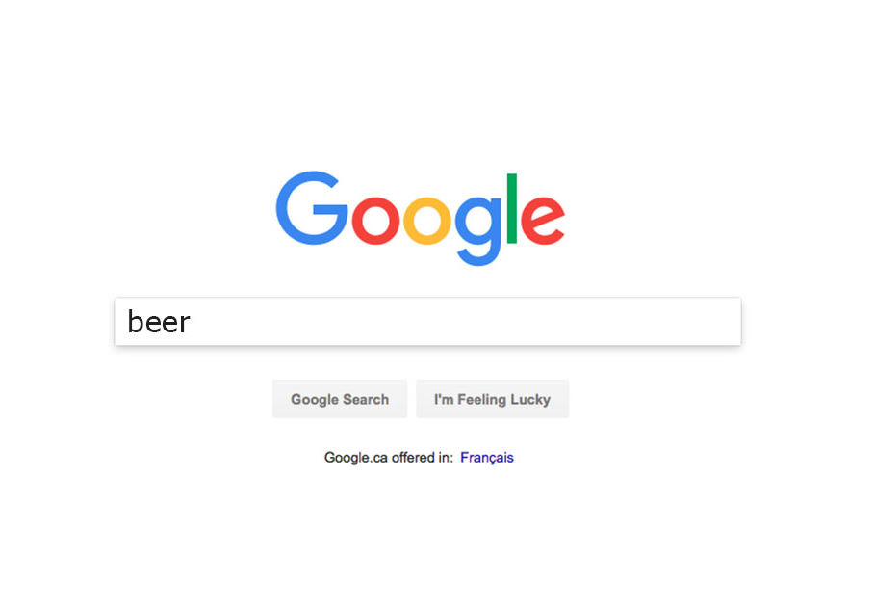
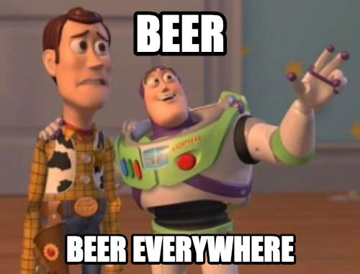
App Overview
What is it?
Search for beers
Rate beers
Beer ratings will go into user’s personal database.
Recommend beers to friends
Key Features:
Beer rating system
Database of beers the user has tried (with rating and other info)
Drink wishlist

Slide 3



Project Overview
App Name: BeerPal
Language: Kotlin
UI: XML
Database: Google Firebase
Design Choices:
Navigation
Fragments
Firebase
RecyclerView
Permission
Repository Pattern
Unit Testing

Slide 4
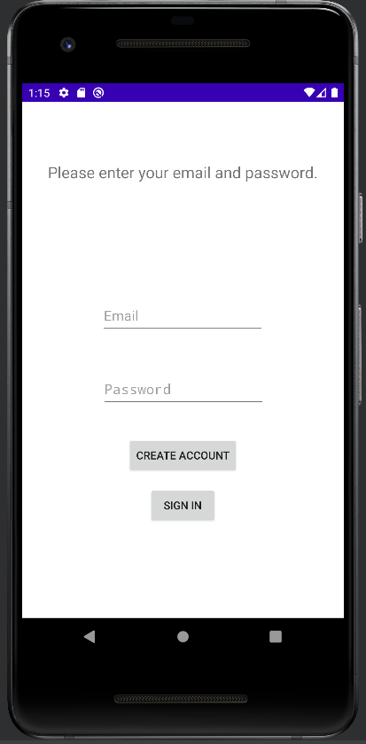
Email Login
Using Firebase Authentication framework
Allows for global access of user details
Secured by Firebase, no storing private user information in plain text.

Slide 5
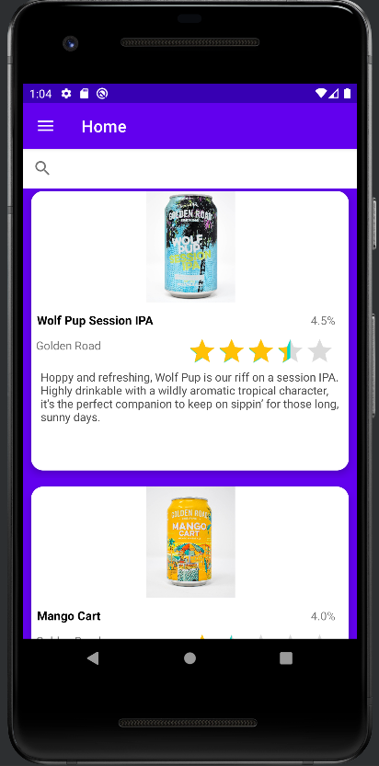
Main Beer Display
Pulls beer info from Firebase
Formats this info into cards
Cards are put into RecyclerView

Slide 6
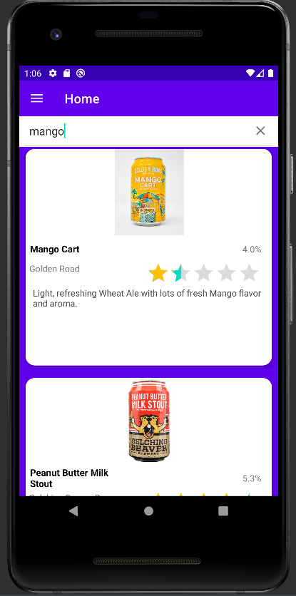
Searchable Beers
Main RecyclerView can be searched
Attempts to filter out irrelevant results
Most relevant results placed at top.

Slide 7
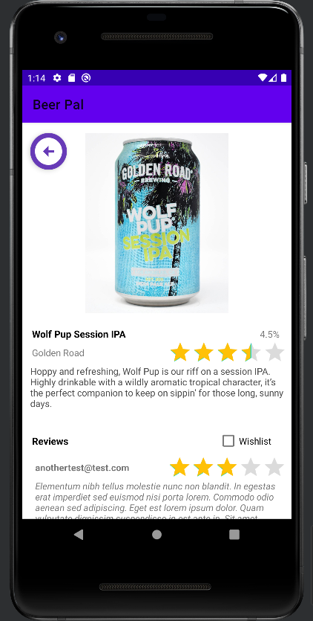
Beer Details
Click on a beer’s card to expand its details page. Reviews can be viewed here.

Slide 8
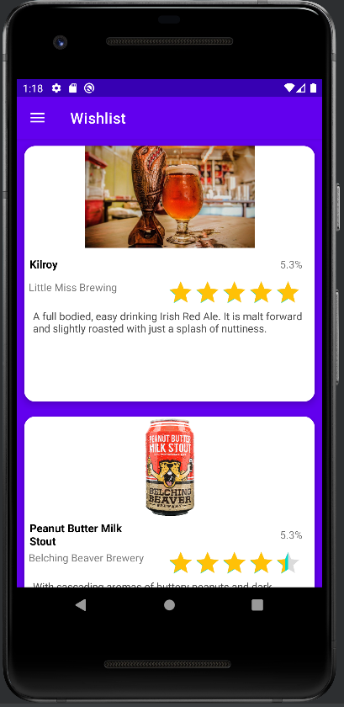
Wishlist
Keeps track of beers a user has added to their wishlist.
Can also expand details page from here.

Slide 9
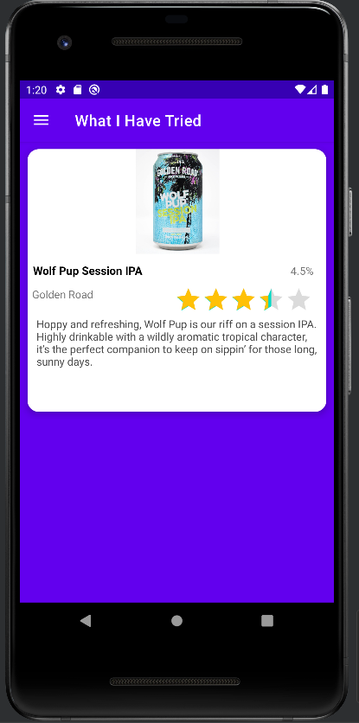
What I’ve Tried
A user might want to see what beers they have had at a glance.
What I’ve Tried page shows all beers a user has rated.

Slide 10
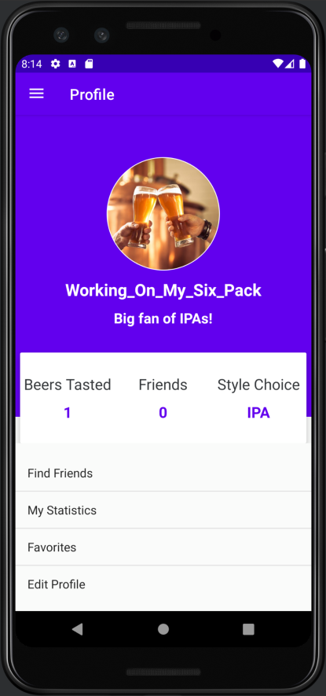
Profile Page
User data is stored and pulled directly from the database.

Slide 11
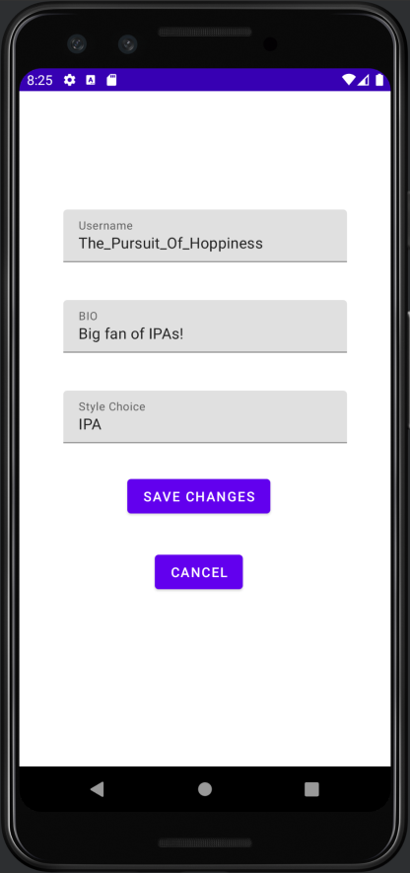
Editing the Profile Page
All fields are populated by current user info from the database.
Save Changes will update the user’s database info
Cancel will exit the user from the activity

Slide 12
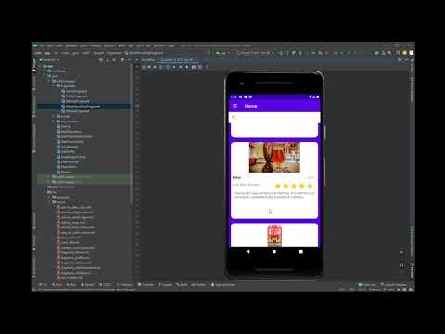
Demonstration

Slide 13
Final Thoughts
Remember Us!
BeerPal App
Developers
Daniel Pierce
Andrew Kuo
Brandon Holder
David Lau
Abdikhalid Abdirahman

